Slide 1
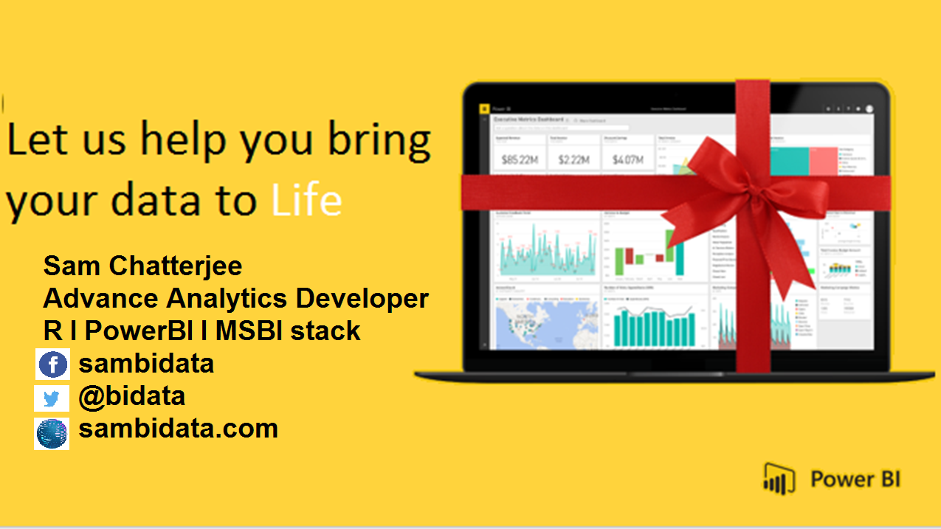

Slide 2

D A X
DATA ANALYSIS AND EXPRESSIONS

Slide 3
Why We need to Learn DAX?
DAX is a formula language associated with the Data modelling.
DAX contains important functions that can be use in Excel Power Pivot.
DAX is only associate with PowerBI.
It’s quite easy to create a new Power BI Desktop file and import some data into it. You can even create reports that show valuable insights without using any DAX formulas at all. But, what if you need to analyze growth percentage across product categories and for different date ranges? Or, you need to calculate year-over-year growth compared to market trends? DAX formulas provide this.
DAX associated with PowerBI

Slide 4
How will you Learn DAX?
By practicising it with your datasets.
By analysing the data and the query given.
What will you gain after DAX?
Creation of amazing data modelling and functions.
It works with relational databases that perform dynamic aggregations.
Can create the difference between excel and dax functions.

Slide 5

How a DAX function is written?

Slide 6
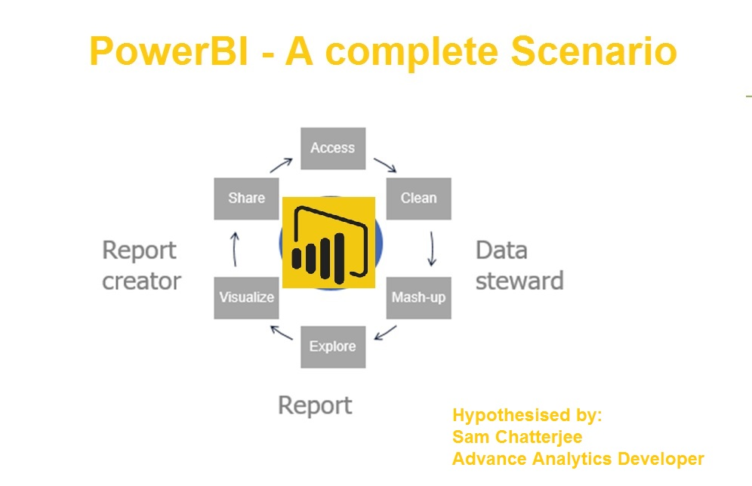

Slide 7
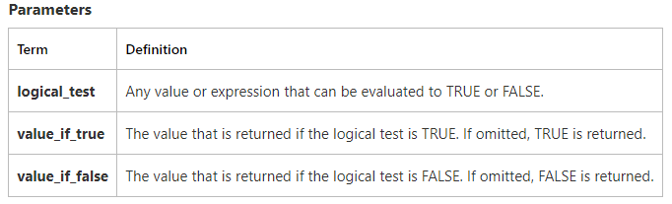
DAX Functions
If condition
Checks if a condition provided as the first argument is met. Returns one value if the condition is TRUE, and returns another value if the condition is FALSE.
IF(logical_test>,<value_if_true>, value_if_false)

Slide 8
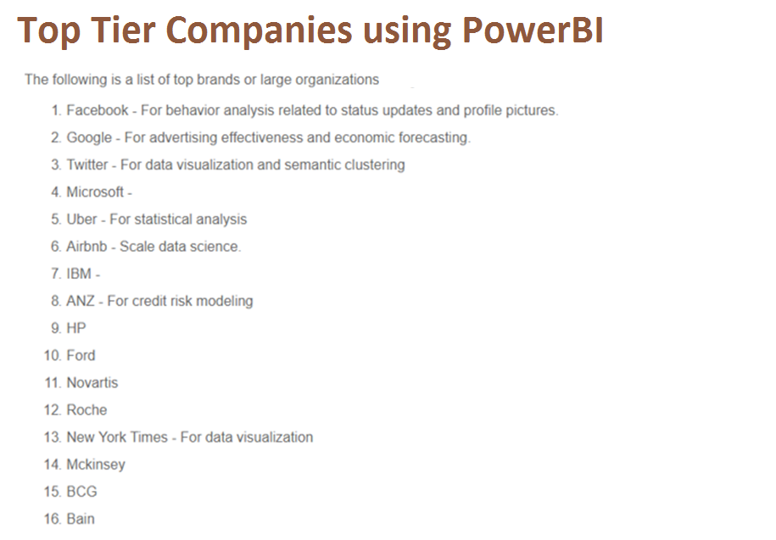
What will you achieve with PowerBI

Slide 9
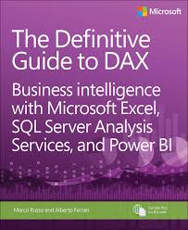
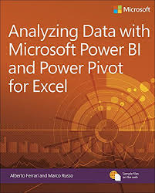
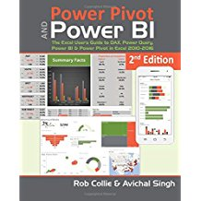
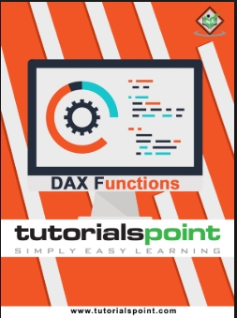
Resources
Get Power BI (Free) http://tinyurl.com/hj5hdg6
Power BI Jump Start http://bit.ly/1ktON16
Power BI Getting Started http://bit.ly/1FF88KA
Power BI Team Blog http://bit.ly/1vwbTLG
Power BI Channel 9 http://bit.ly/1a9Q0gv
Power BI https://powerbi.microsoft.com

Slide 10

Empower today’s innovators to unleash the power of data and reimagine possibilities that will improve our world

